Slide 1
Optimize MEDITECH Expanse with a Secure and Convenient Mobile Strategy

Slide 2
Presenters
David Dean President & CEO, ACS MediHealth
Notes:
Introductions
Lee – Slides 3-6
David – Slides 7-8
Lee – Slides 9-10
Both – Slide 11
David – Slides 12-18
Lee – Slides 19-21
Both – Slide 22 (Close it out)

Slide 3
FORWARD ADVANTAGE Our Experience
28+
Worked Together to Deliver Mobile Strategy Solutions to Hundreds of MEDITECH Hospitals
Years in Healthcare
Bringing Together Device Expertise and Secure Access & Interoperability Expertise to Deliver a Comprehensive Solution

Slide 4
BENEFITS & CHALLENGES of a Mobility Strategy

Slide 5
Benefits of Mobile Devices at the Point of Care
DOCUMENT WITHOUT DISTRACTIONS
Improves The Patient Experience By:
Improves The User Experience By:
Web-based, mobile solutions
Fast and flexible touch interface
Access to patient information on mobile devices from wherever you may be
Bringing chart navigation and documentation to the bedside
Recording vitals and administering medications without disturbing other patients in the room
Allowing patients to have more face-to-face time with their clinicians
Giving clinicians more time back in their day
Reducing reliance on WOWs – because you’re using the right device for the right job
Providing instant access to patient charts with a simple wristband scan

Slide 6
The Benefits and Challenges OF USING SHARED CLINICAL MOBILE DEVICES
Benefits
Challenges
Facilitate clinical mobility…
…without disrupting workflow?
Enable new workflows at the bedside…
…while protecting access to PHI?
…without creating barriers to care?
Improve security…
Notes:
As you know, your clinical staff is mobile, moving throughout the hospital as they care for patients.
As a result, the use of mobile devices continues to increase. In particular, the use of enterprise-owned, shared devices from manufacturers such as Zebra, Honeywell, and others.
These devices have a number of benefits, but they also present some challenges. In particular, how to unlock the full value these devices deliver while also ensuring security and protecting PHI.
There are a number of considerations when implementing these devices and mobile applications. For example:
((CLICK))
These devices facilitate increasing clinical mobility by enabling patient identity management, clinical communications, lab collections, and a number of other mobile workflow. But it’s important to consider workflow, and make sure these devices and applications are usable so you will drive adoption and realize their full potential as a valuable tool in the delivery of care.
((CLICK))
Also, these devices are purpose-built for healthcare to put the power of technology in your clinicians hands at the bedside to automate workflows that were once manual. But because they are shared devices, how can you be sure you are protecting access to PHI to ensure only authorized users have access to specific patient information?
((CLICK))
And because these are enterprise owned devices, you have more control over their use and therefore improved security vs. individual users’ devices. But, as is crucial in many areas of healthcare IT, how can you enable this security in a seamless way that does not create a barrier to patient care?

Slide 7
Successful Mobile Device Strategy
LOOK AT DEVICE STRATEGY AS A WHOLE
Endpoint Device Management
Selection of Devices
Managing Updates
Managing Security
Select the Right Software

Slide 8
Endpoint Device Management
THINGS TO BE AWARE OF/RISKS
Devices disappearing/lack of tracking/device management
OWNERSHIP/GOVERNANCE
BYOD strategy or physician owned
Remote management & controlled access
Provisioning of devices

Slide 9
BEST Practices

Slide 10
Best Practices
Know Your Strategy Up Front
Elbow to Elbow Training
Have a Good Partner vs. Standard Purchasing Agent
Assign and Train Power Users
Make Sure Vendor/Partner has Done this with Other Sites & has Expertise with MEDITECH and Advisor

Slide 11
Good Examples
Notes:
KDMC, Holeyoke, Avera
- having strategy in place, having super users for devices, deploying in phases, elbow to elbow very successful
- unsuccessful- holding devices and training until go live- user frustration, more IT support, if you don't engage providers and care team up front, more difficult adoption

Slide 12
SELECTING the Right Device

Slide 13
Selection of Devices
Review MEDITECH enabled options
Review Pro's/Con's
Review best practices & lessons learned, things to consider
Evaluate devices to find the best fit
Order early to help limit the challenges of supply chain issues and to keep on schedule
Notes:
David send slides- visual of devices (focus on POC and mobile phlebotomy)

Slide 14
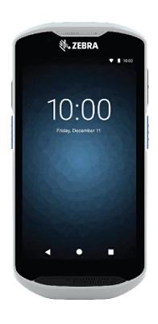
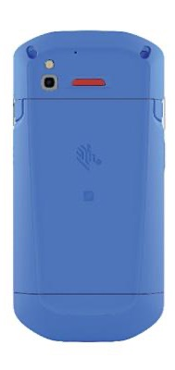
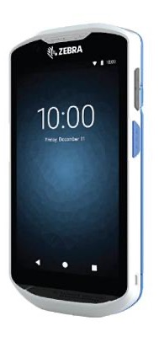
CLINICAL MOBILE DEVICES Zebra TC52x/ax
TC52X-HC
Scans 1D & 2D Barcodes
IP65 for durability
Healthcare Cleanable
Replaceable Battery
NFC Built in for MDA SSO
5” Display
Android 8.1 & 10
Voscera Compatible
Mobile Device Access Compatible

Slide 15
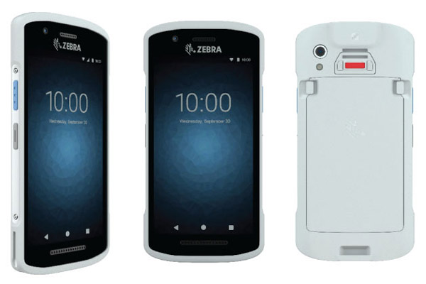
CLINICAL MOBILE DEVICES Zebra TC21
TC21-HC
Camera-based Scanner: 1D & 2D Barcodes
IP67 for durability
Healthcare Cleanable
Replaceable Battery
NFC Built in for MDA SSO
5” Display
Android 11 upgradeable to 14
Unified Communications
Mobile Device Access Compatible

Slide 16
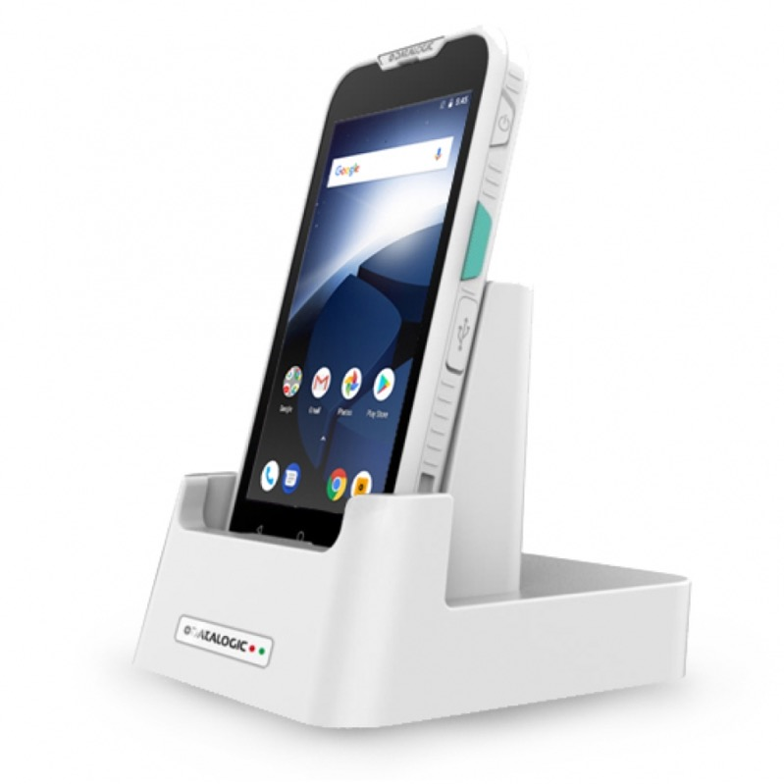
CLINICAL MOBILE DEVICES Datalogic
MEMOR 10
Scans 1D & 2D Barcodes
IP65 for durability
Healthcare Cleanable
Qi Compliant for charging
Replaceable Battery
NFC Built in for MDA SSO
5” Display
Android 8.1 & 10
Voscera Compatible
Mobile Device Access Compatible

Slide 17
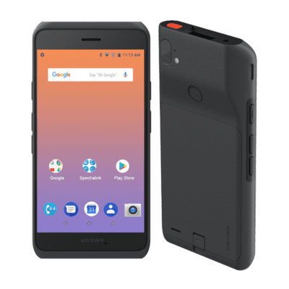
CLINICAL MOBILE DEVICES Spectralink
VERSITY 9540
Scans 1D & 2D Barcodes
IP65 for durability
Healthcare Cleanable
Replaceable Battery
NFC Built in for MDA SSO
5” Display
Android 8.1 & 10
Voscera Compatible
Mobile Device Access Compatible

Slide 18
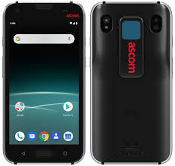
CLINICAL MOBILE DEVICES Ascom
Myco 3
Scans 1D & 2D Barcodes
IP67 for durability
Healthcare Cleanable
Replaceable Battery
NFC Built in for MDA SSO
5” Display
Android 8.1
Voscera Compatible
Mobile Device Access Compatible

Slide 19
Managing Updates & Security
Alignment of Device Strategies & Timing
Will you have mixed OS environment?
How will you roll out?
Best Practices
Do updates in test environment first
Roll out early
MDM
Warnings/Risks
Do in sandbox, test test test
Know difference between platforms (iOS vs. Android)
Why Security is Important
PHI
Access Control
Applications

Slide 20
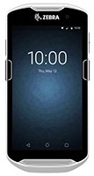
Security vs. Convenience FOR CLINICAL STAFF
Shared mobile devices can be used to access PHI, so they require security measures to be put in place
This includes enforcing users to authenticate to unlock the device, and then to access each application
Often this authentication is a unique, manually entered username and password…
Application
Application
USERNAME
********
Application
Application

Slide 21
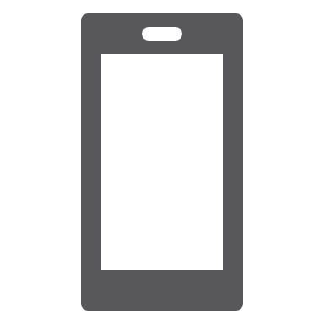
Authentication Considerations
Improve Security By Combatting Phishing and Other Targeted Attacks
Enable Multifactor Authentication For All Enterprise Users
Clinical Staff
Administrative Employees
Affiliates
Contractors
Ensure Efficiency Through Fast, Convenient Push Token Notification
Username
Multifactor
Authentication
*********
123456
SMS
Notes:
Recommend Hiding/Removing

Slide 22
Selecting the Right Solution
Why This Matters
Options to Consider/Pros & Cons
Multiple required components
Many solutions don't do everything as promised
Need supported devices that work with your workflow
Select Mobile Device Management (MDM)
Decide on unified communication strategy
MEDITECH Browser set-up (mobile URL)
What Different MEDITECH Sites Are Doing
Notes:
Create slide with recommended steps

Slide 23
Best Practices and Next Steps to Prepare
01
Decide on Strategy what you are trying to accomplish
02
Reach Out to a Trusted Provider that understands the devices, security, MDM, and MEDITECH

Slide 24
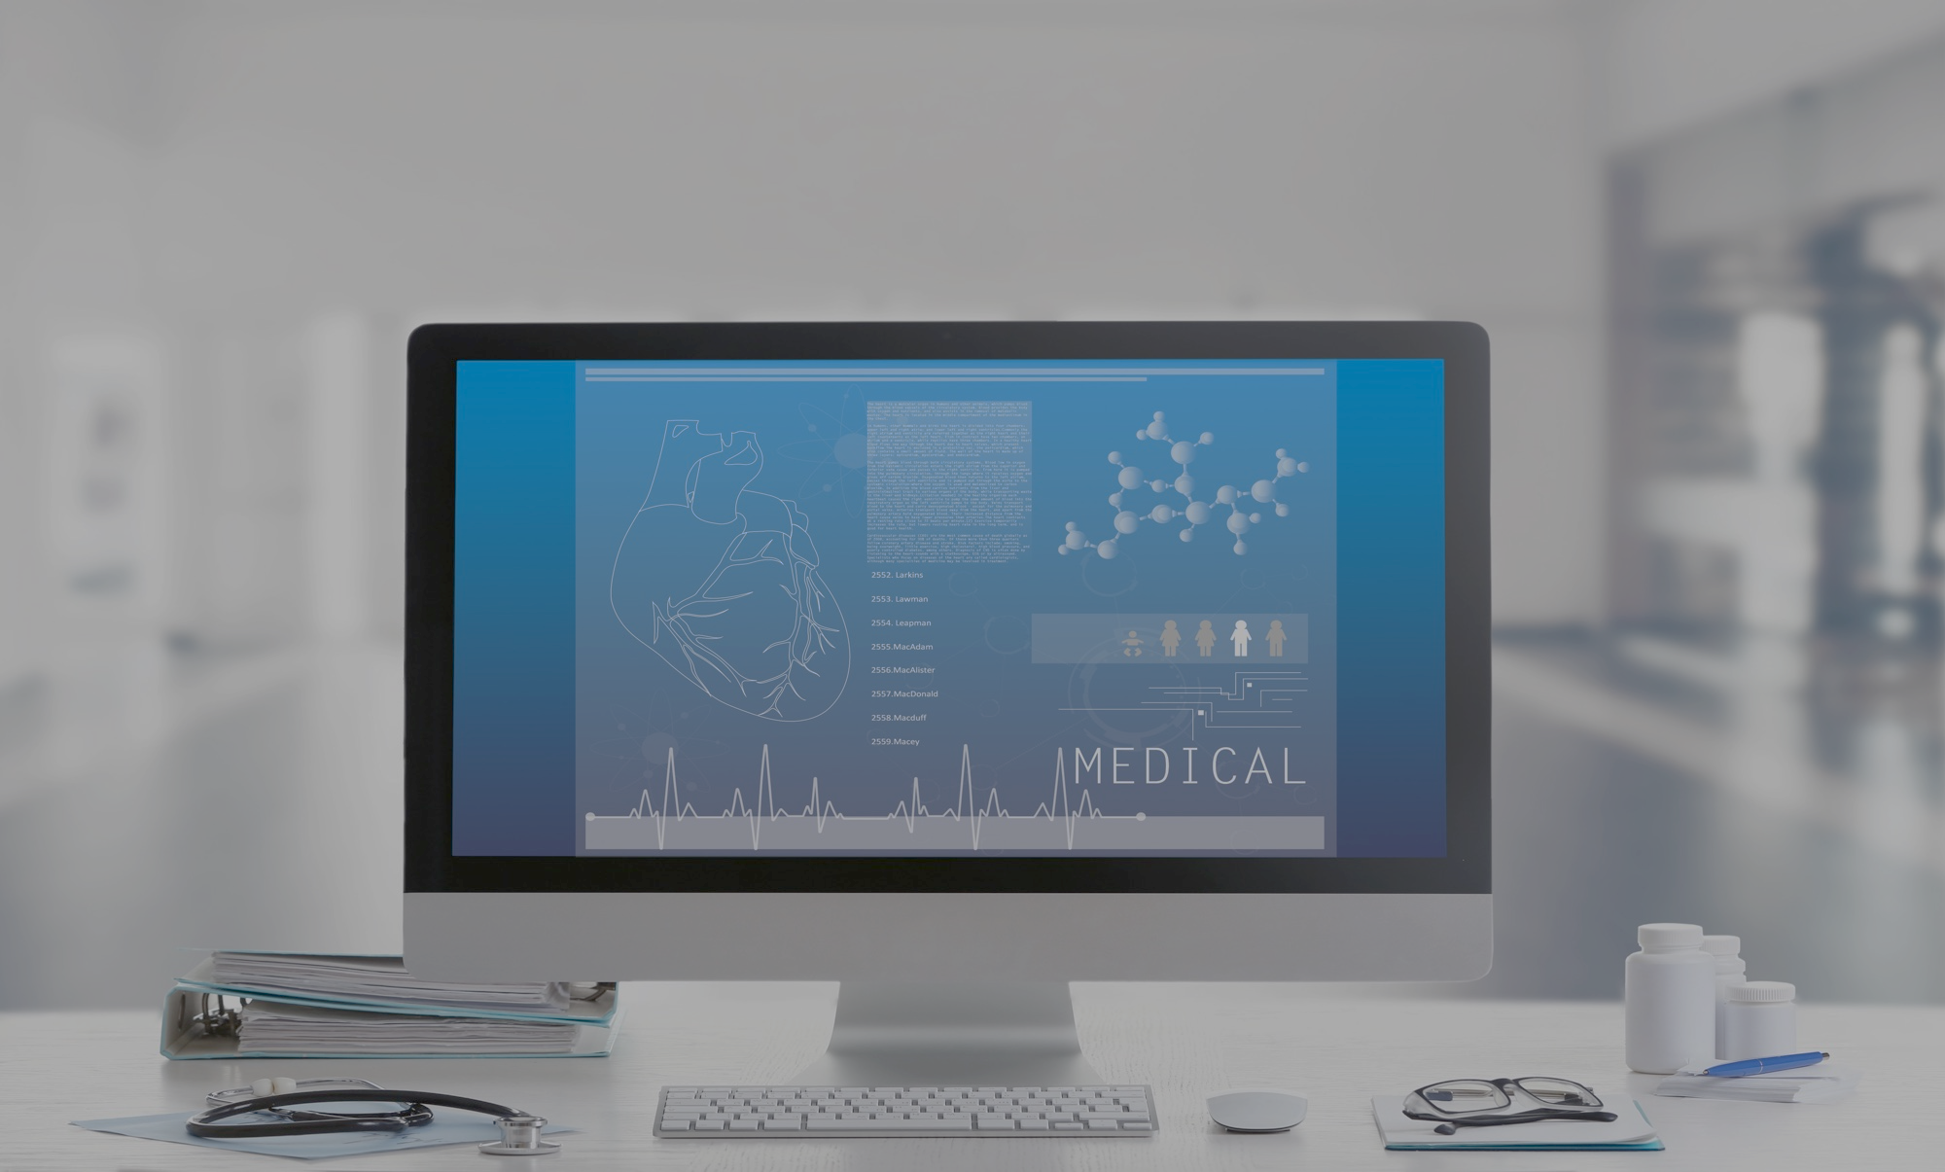
ACS MediHealth
1925 Grassland PKWY
Alpharetta, GA 30004
800-488-3304
djdean@acs-ebiz.com
www.acsmedihealth.com
Notes:
More questions
Thank you for time
Contact review & Next steps

